Slide 1


Chapter 5
A menu-driven app to monitor important indicators

Slide 2
Learning objectives
1. How to secure an app with a password
2. How to create a numeric pad for input
3. How to navigate using menus

Slide 3
Thyroid app design
Used to help medical patients with thyroid cancer track and analyze important indicators using the results of their various tests.
Users of the app will be able to
record important indicators from their medical test results
view the history of their records
analyze what those results mean to them
receive basic advice on when they should seek medical help
Security is very important for this app.

Slide 4
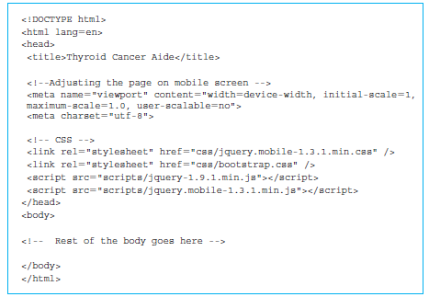
Overview of the functionality of the Thyroid app

Slide 5
Features of the app
Password protection
Ability to change the password
Storing information (including password) locally on the device
Making sure that the user has agreed to terms and conditions or disclaimers
Acquiring basic information from the user
Editing the basic information

Slide 6
Features for managing the history
Creating new entries
Editing existing entries
Deleting individual entries
Editing individual entries
Clearing the entire history
The historical values of the indicators can be analyzed with the help of the following facilities:
Tabular view of the history
Graphical view of the history
Advice using graphical widgets

Slide 7
Numeric pad for password entry
We have a <div> section with the data-role attribute value of “page”.
The data-role of “header” can be seen as the <head> section in a traditional HTML page with a single screen.
The data-role of “content” corresponds to the traditional <body> section.
Text box for entering the password with the HTML5 code:
<input type="password" id="passcode"></input>

Slide 8
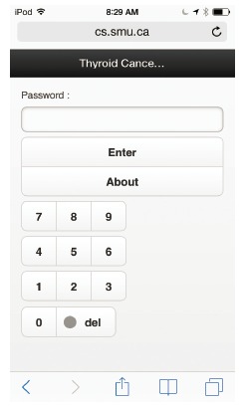
Screenshot of the entry page in the Thyroid app

Slide 9
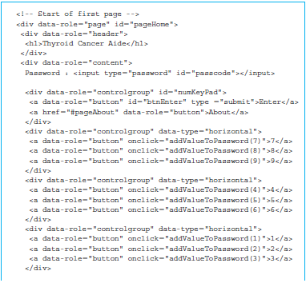
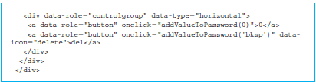
HTML5 code for the Thyroid app

Slide 10
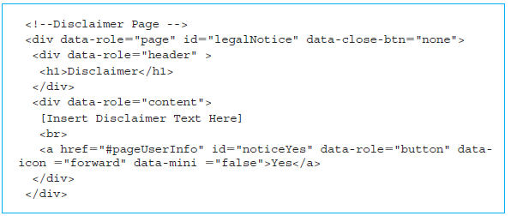
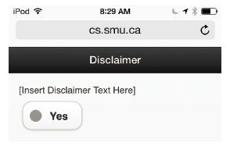
Disclaimer and help pages
When a user successfully enters the password (2345 for the first time), that user is led to the disclaimer page.

Slide 11
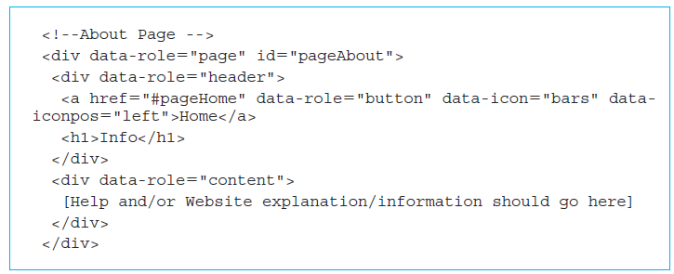
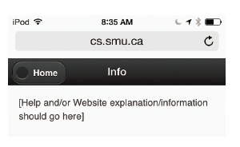
Disclaimer and help pages (cont’d)

Slide 12
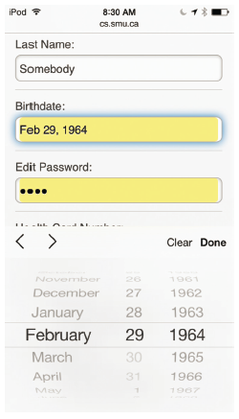
User information entry form
Acquire a significant amount of information from the user.
The entire page is contained in a <div> section with data-role “page”.
Its id attribute is set to “pageUserInfo”.
Header has two <a> elements with data-role “button”.

Slide 13
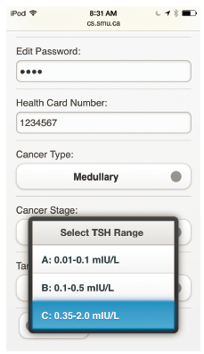
Screenshot of the user information form in the Thyroid app—II
The physician specifies a range of TSH values based on clinical examination.
The patients will regularly enter the TSH values obtained from a blood test.
App will plot the history of TSH values and also provide some guidance to the patient.

Slide 14
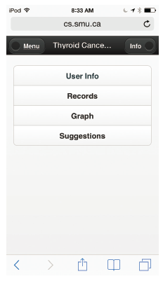
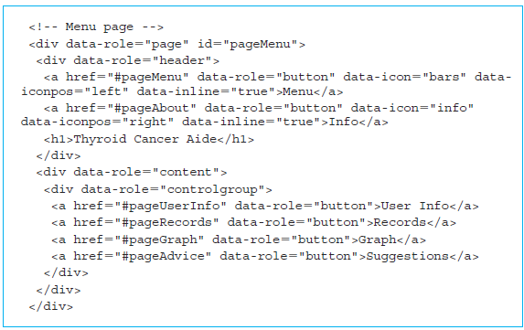
Navigation with a menu
The id attribute for this page is set to “pageMenu”.
The header has two <a> elements with data-role “button”.

Slide 15
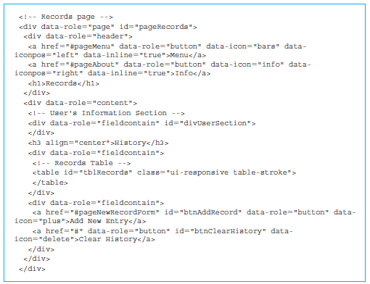
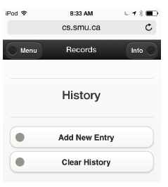
Record display and update page
The entire page is contained in a <div> section with data-role “page”.
Its id attribute is set to “pageRecords”.

Slide 16
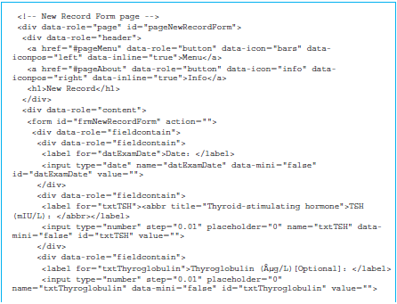
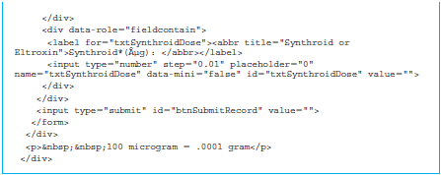
Page to add a record
The <h1> element with “New Record” title completes the header section.
<div> with data-role “fieldcontain” section used to group the first four buttons.

Slide 17
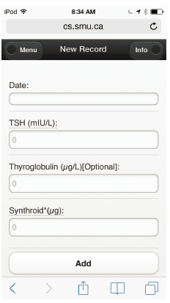
Screenshot of the new record page in the Thyroid app

Slide 18
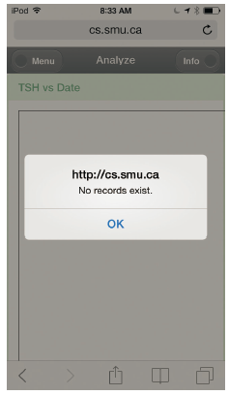
Use of canvas and panels for graphical display
The entire page is contained in a <div> section with data-role “page”.
Its id attribute is set to “pageGraph”.
The header has two <a> elements with a data-role “button”;
One takes us to the Menu Page and the other to the Information Page.

Slide 19
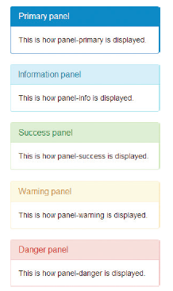
Use of canvas and panels for graphical display (cont’d)
The panel element is from the Bootstrap library.
Put our content in a box with a border and some padding around the content.

Slide 20
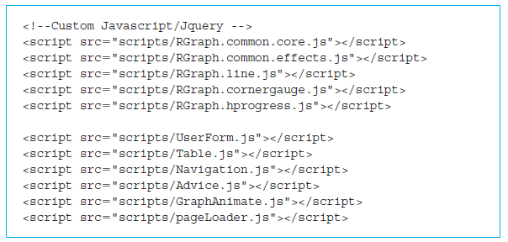
Use of canvas and panels for graphical display (cont’d)
JavaScript builds the responsive and interactive features. There are two aspects to our JavaScript functionality:
1. data storage and management
2. graphics

Slide 21
Quick facts/buzzwords
Bootstrap
Password
Data-role = button
Data-close-btn
Data-icon
Data-iconpos
Data-mini
Data-inline
Panel
Panel type
Panel-heading
Panel-body

